Slide 1


DewGarden

Slide 2

DewGarden
Women Hygiene
“Because you are the hallmark of cleanliness & good health”
A modern woman deals with a lot of challenges and stress in her regular course of life, at work and at home
Cleanliness and tenderness are basic feminine characteristics, which she not only practises, but also inspires the world to practice
In her pursuit of achieving success in life, she must also take care of herself in more ways than one
Intimate hygiene is one of the core areas of self-care that she must focus upon to stay healthy and free from worries

Slide 3
DewGarden
In the pursuit of empowering modern women with good health and a better quality of life, Vestige is introducing its Women’s Hygiene brand – “DewGarden”
Under this brand, Vestige will bring truly remarkable products that not only care for women’s hygiene needs in multiple ways, but also adds to her confidence, inner beauty and feminine tenderness through an uncompromising combination of hygiene and self-care

Slide 4

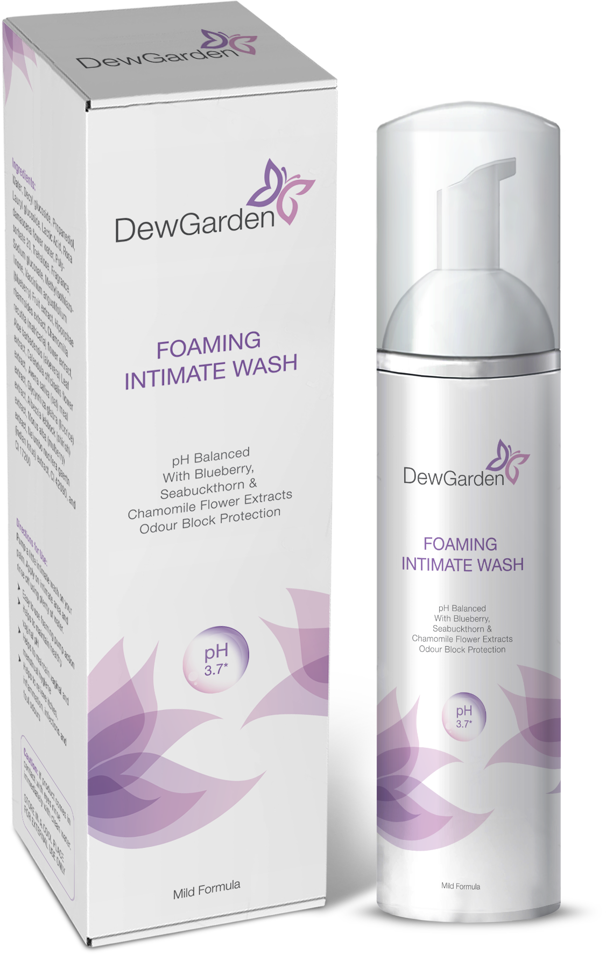
Introducing
DewGarden Foaming Intimate Wash

Slide 5

Intimate Hygiene
Tissues of intimate area are extremely sensitive
Washing too little or too much or using unsuitable products can upset the balance of protective flora in the intimate areas, leading to irritation and infections
It is important to follow simple rules of intimate hygiene not only to prevent infections but to keep yourself clean and fresh

Slide 6
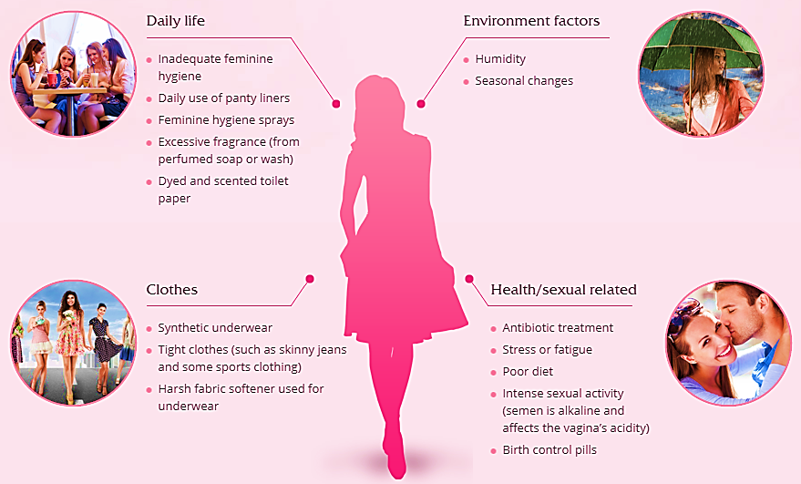
Factors affecting- Intimate Area’s Natural Balance

Slide 7
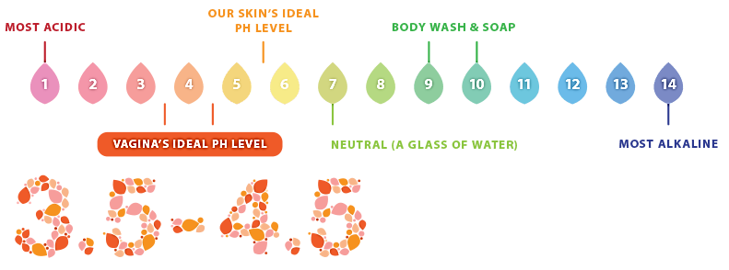
Intimate Area pH
The normal healthy vagina pH is between 3.5-4.5 which is ideal for survival of good bacteria. If this delicate balance is disturbed, harmful bacteria can multiply, leading to vaginal discomfort symptoms like foul odor, irritation & vaginal discharge

Slide 8

DewGarden Foaming Intimate Wash
DewGarden Foaming Intimate Wash is a soap-free and alcohol-free solution with a pH of 3.7± 0.5, which is ideal for the female intimate area
It contains the extracts of Blueberry, Sea buckthorn and Chamomile Flower, which offer a pleasant and soothing fragrance with an odour-block protection power
It is safe and suitable for all skin types

Slide 9
DewGarden Foaming Intimate Wash- Benefits
Prevents unpleasant odour
Prevents vaginal itching and irritation
Maintains the natural pH balance of intimate area
Protects vaginal flora
Maintains vaginal hygiene
Prevents vaginal infections
Maintains everyday freshness

Slide 10
hhhhhhhhhhhhhhhh
Why you should use Intimate wash?
Irritation, dryness, inflammation, infection, hormonal changes – The intimate area goes through a lot, which is why you need special care to pamper and protect your intimate area
Most women believe that using soap or only water is sufficient for their daily intimate hygiene
But most soaps have a pH value ranging from 8-10, which disturbs the pH balance of your intimate area
The pH of your intimate area ranges from 3.5-4.5
Ordinary alkaline soap destroys the natural acidic protective layer of the intimate skin; hence, it is important to use a special product “DewGarden Foaming Intimate Wash”, which helps maintain the natural pH of the intimate area

Slide 11
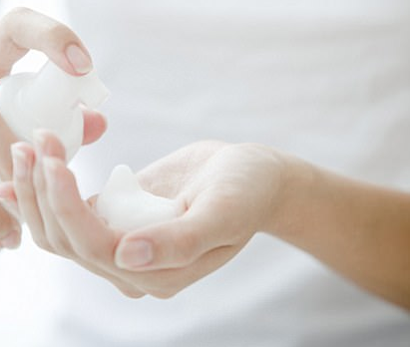
DewGarden Foaming Intimate Wash- How to Use
Wet the intimate area
Pump a little intimate wash on your palm
Apply externally on the intimate area
Rinse thoroughly with water
Use DewGarden Foaming Intimate Wash at least twice daily (during morning showers & at night before sleep)

Slide 12
Tips for maintaining Intimate Hygiene
Try to avoid wearing tight-fitting synthetic wear undergarments
It is recommended to wear cotton undergarments
Wash intimate areas twice daily, morning & evening
Rinse well after washing intimate areas
Avoid douche (spraying the vagina with water), we may think that we’re eradicating bad odour or menstrual residue, but in actual fact, we’re affecting the vagina’s natural pH balance
Hygiene during menstruation
Change sanitary napkin on a regular basis, at least 2-3 times a day
Wash intimate areas more frequently if required

Slide 13
DewGarden Foaming Intimate Wash
MRP Rs. 210
DP Rs. 180
BV 108
PV 6

Slide 14


